Slide 1



Slide 2

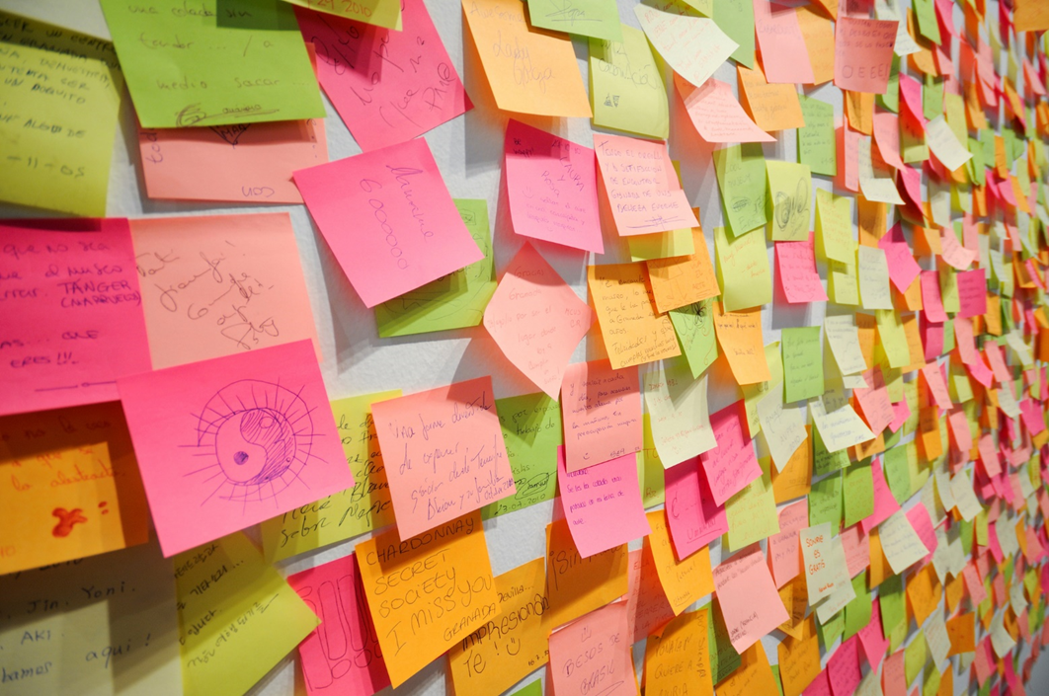


1
Notes:
Today i ll be telling the story of Samar, a young lady, mother of a child and a full time employee, a busy woman, right ? ,,,, Samar is very ambitious, she always wants to learn new skills, practice sport, stay healty and take care of her family but with her busy scheduel, it is dificult,
Many of us are like Samar, we want to do a lot and we can’t help accomplishing just a little, many are the to lists that stayed attached to our walls without crossing anything out of them ,,,, what is the somution you ask ?
Researches showed that sharing your to do lists with other impulses you to finish them, makig commou, challenges with your freinds gives you more motivation and makes it more fun .

Slide 3

2
Notes:
We inspire is a team of architects, ingeneers, future entrepreneurs, we want to make it easier for you and help achive all your goals, together we created a plate forme that offers you a personal space where you can creat to do lists, share them others, lanch challenges with your friends and rise the flag of motivation up to the sky
Dpn’t hesitate to join our community cause we promise to provide you a remarkable one of a kind experince
How does it work ?
I ll let you with my friend to take you throught the process

Slide 4



Back-end
Front-end
Get Data
Reset API
HTTP
Store Data
Happy Users
3
Notes:
Ayoub

Slide 6
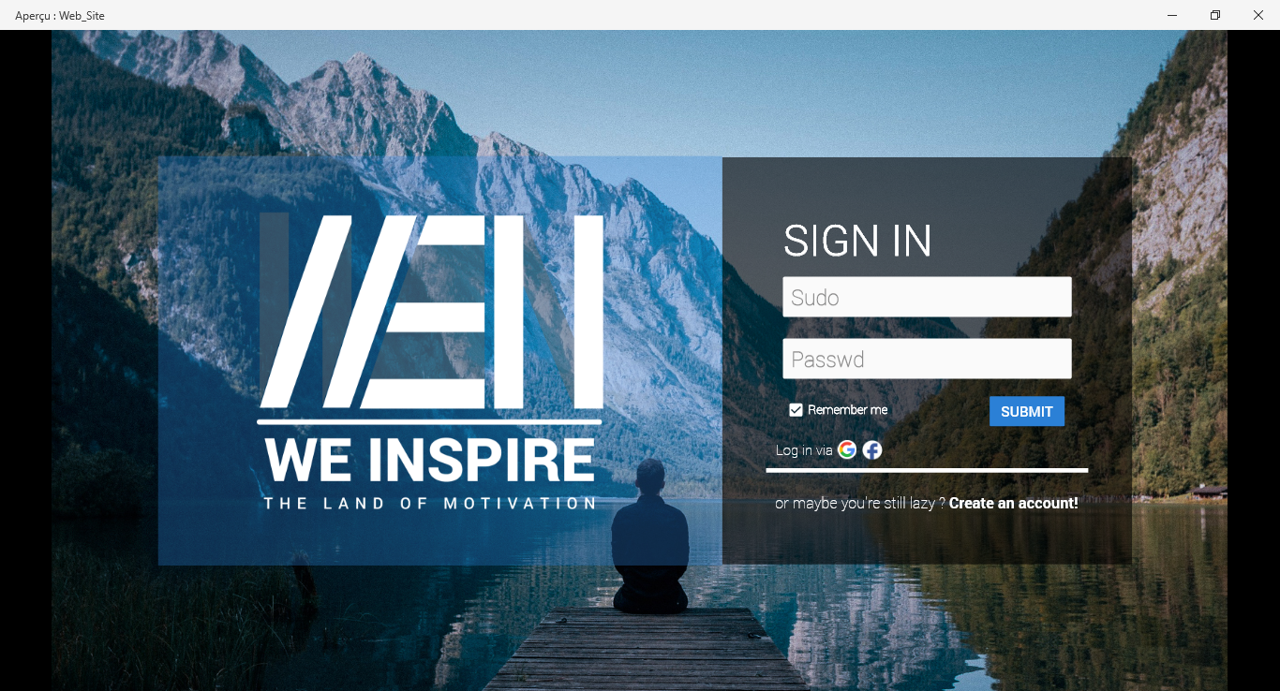
4
Notes:
our platforme’s desing focuses on providing the user the best experinece possible from the choice of colors to the pleasurable journey

Slide 7

5
Marketing
Notes:
But sometimes what realy makes the difference is the marketing, yassir is a good example for that, the main key to succed a marketing campain is to know where you can find your segment of audiance to know where to place your efforts, we are targeting people aged 20-40 student and employees with busy shceduel , we can reach them on social media TV or even by bill boards when they are on their ways back home ,,,,, and in other places like gyms and schools

Slide 8
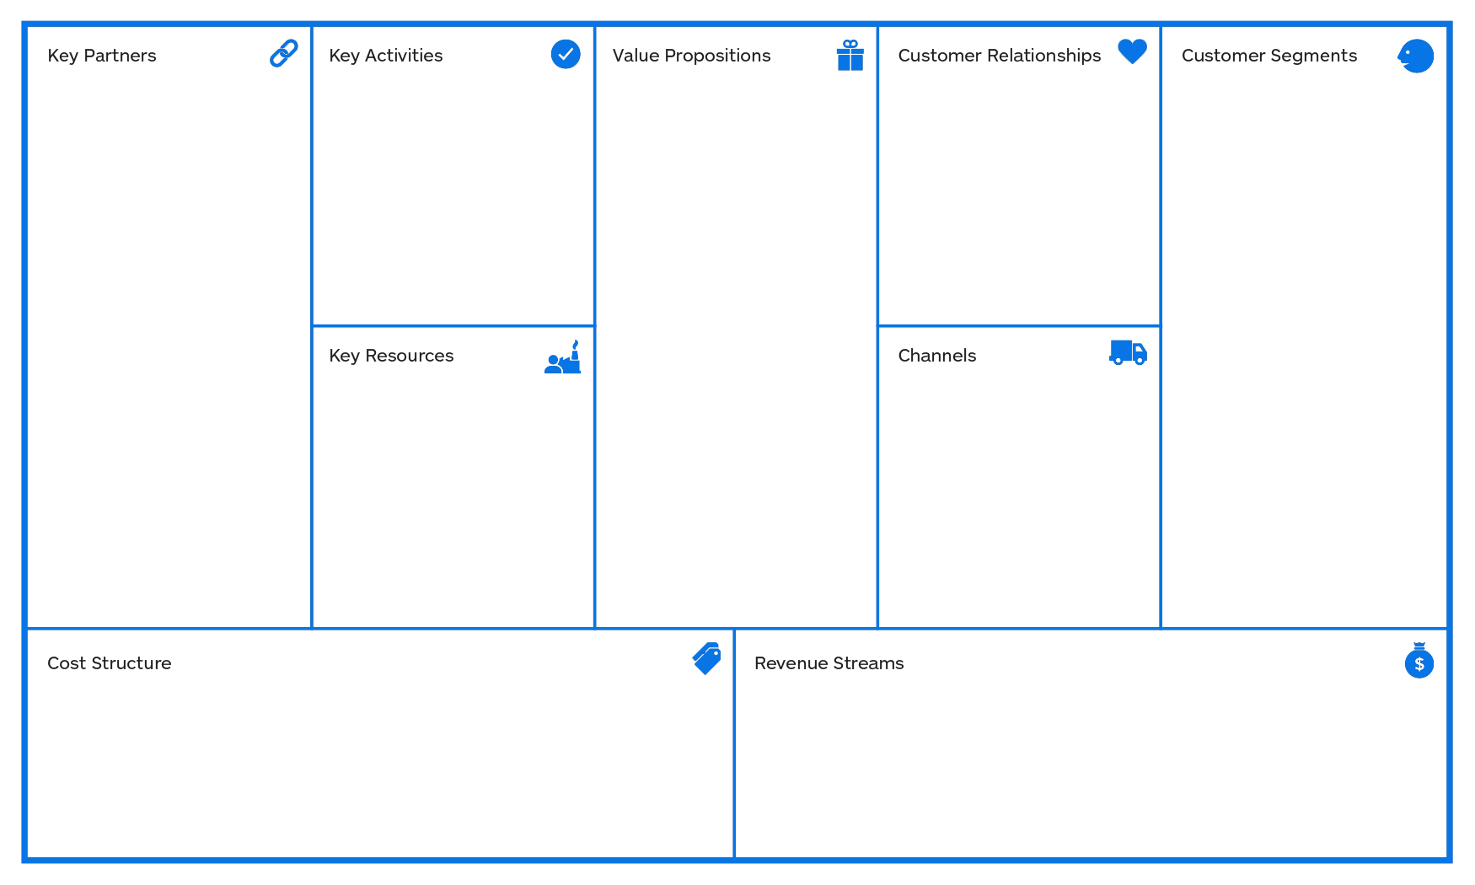
-Gyms
-Private schools
-Motivational speakers
-personal development coaches
Create an account
Connect
Share
Launch challenges(individual or in group)
Create To Do Lists
Join groups
Choose centers of interest
-a pleasurable easy user experience
Using Artificial Intelligence to help
users estimate time needed to accomplish their tasks and generate
Their planning
Level upgrade
Giving the user the possibility to become a coach
Giving regular users free sessions with professional coaches
Employees
students.
People aged 20-40
connexion
Humane resources:
Developers
Designers.
Social media
TV
Bill boards
Advertisement in gyms, schools…
Internet network
Servers
Employees’ payment.
Targeted publicity based on each user’s interest
6
Notes:
Cause we are partnering with them( like you see on our BMC) by targeting their publicities to the right audiance using the plateform data base
Now what distingushes us from others ,,,, what is our WOW ,,,,, in addition to offering a pleasurable super easy user experience we are using Artificiel Intelegent to help users estimate the time they need to accomplish their task and generate their plannings .

Slide 9
Demo
7

Slide 10
Thank you !
8

